Slide 1

Capstone Project
Airbnb Bookings Analysis
By - Sarang_Gami
Sarang.gami.24@gmail.com

Slide 2

Points For Discussion
Introduction of Airbnb
About the Dataset – Airbnb Bookings NYC
Project Summary Of EDA
Understand The Given Variables
Problem statements
Data Visualization and Observations
Conclusions

Slide 3

Introduction of Airbnb
Airbnb is a popular online platform that allows individuals to
list, discover, and book unique accommodations around the
world. It was founded in 2008 by Brian Chesky, Joe Gebbia
and Nathan Blecharczyk, and has since become the largest
and most successful home-sharing companies in the world.
Airbnb allows hosts to list their homes, apartments, or other properties for short-term rentals, and provides a platform for travelers to search for and book these accommodations. The
platform includes a variety of listing types, including entire
homes, private rooms, and shared rooms, and offers a wide
range of price points to suit different budgets.
Airbnb has also become a popular choice for travelers who
want to experience a destination like a local, rather than as
a tourist. With more than four million listings in over 100,000
cities.

Slide 4
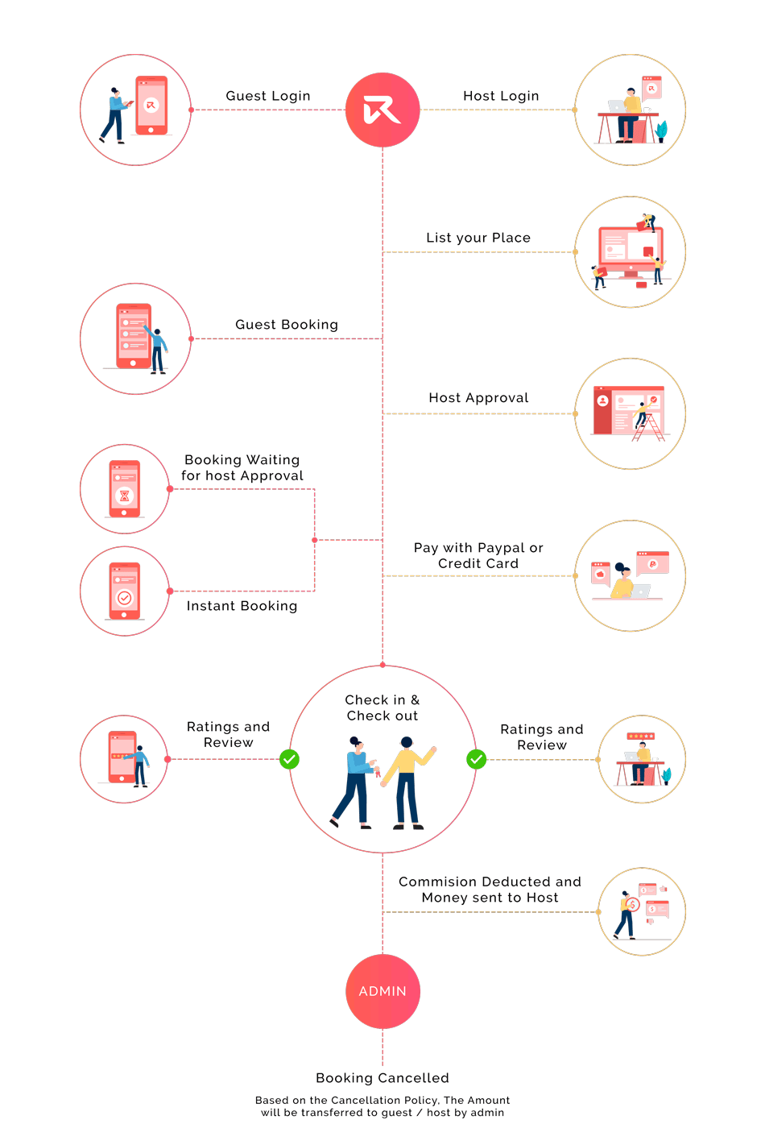
About the Dataset – Airbnb Bookings
This Airbnb dataset contains 49,000 observations from New York , with 16 columns of data.
The Data includes both categorical and numeric values, providing a diverse range of information about the listings.
This Dataset may be useful for analyzing trends and patterns in the Airbnb market in New York and also gain insights into the preferences and behavior of Airbnb users in the area.
This dataset contains information about Airbnb bookings in New York City in 2019. By analyzing this data, you may be able to understand the trends and patterns of Airbnb use in the NYC.

Slide 5
Project Summary Of EDA
The Summary Of The Analysis :- Understanding the factors that influence Airbnb prices in New York City, or identifying patterns of all variables and Our analysis provides useful information for travelers and hosts in the city and also provides some best insights for Airbnb business.
This project involved exploring and cleaning a dataset to prepare it for analysis. The data exploration process involved identifying and understanding the characteristics of the data, such as the data types, missing values, and distributions of values. The data cleaning process involved identifying and addressing any issues or inconsistencies in the data, such as errors, missing values, or duplicate records and outliers.
Through this process, we were able to identify and fix any issues with the data, and ensure that it was ready for further analysis. This is an important step in any data analysis project, as it allows us to work with high-quality data and avoid any potential biases or errors that could affect the results. The clean and prepared data can now be used to answer specific research.
Using data visualization to explore and understand patterns and the observations and insights we identified through this process will be useful for future analysis and decision-making related to Airbnb. and also Our analysis provides useful information for travelers and hosts

Slide 6
Understand The Given Variables
Listing_id :- This is a unique identifier for each listing in the dataset.
Listing_name :- This is the name or title of the listing, as it appears on the Airbnb website.
Host_id :- This is a unique identifier for each host in the dataset.
Host_name :- This is the name of the host as it appears on the Airbnb website.
Neighbourhood_group :- This is a grouping of neighborhoods in New York City, such as Manhattan or Brooklyn.
Neighbourhood :- This is the specific neighborhood in which the listing is located.
Latitude :- This is the geographic latitude of the listing.
Longitude :- This is the geographic longitude of the listing.
Room_type :- This is the type of room or property being offered, such as an entire home, private room, shared room.
Price :- This is the nightly price for the listing, in US dollars.
Minimum_nights :- This is the minimum number of nights that a guest must stay at the listing.
Total_reviews :- This is the total number of reviews that the listing has received.
Reviews_per_month :- This is the average number of reviews that the listing receives per month.
Host_listings_count :- This is the total number of listings that the host has on Airbnb.
Availability_365 :- This is the number of days in the next 365 days that the listing is available for booking.

Slide 7
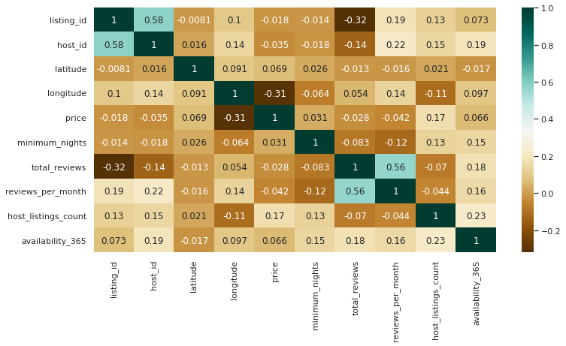
Correlation Heat Map Visualization
OBSERVATIONS :-
There is a moderate positive correlation (0.58) between the Host Id and Id columns, which suggests that hosts with more listings are more likely to have unique host IDs.
There is a weak positive correlation (0.17) between the price column and the Host Listings Count column, which suggests that hosts with more listings tend to charge higher prices for their listings.
There is a moderate positive correlation (0.23) between the Host Listings Count column and the availability_365 column, which suggests that hosts with more listings tend to have more days of availability in the next 365 days.
There is a strong positive correlation (0.58) between the Number Of Reviews column and the Reviews Per Month column, which suggests that listings with more total reviews tend to have more reviews per month.

Slide 8
Problem statements
(1) Find Distribution Of Airbnb Bookings Price Range.
(2) Find Total Listing/Property count in Each Neighborhood Group in NYC.
(3) Find Average Price Of listings/property in each Neighborhood Groups and also Neighborhoods.
(4) Find Top Neighborhoods and Hosts by Listing/property in entire NYC.
(5) Find the Number Of Active Hosts Per Location by Each Neighborhood Groups.
(6) Find Total Counts Of Each Room Types in entire NYC.
(7) Find Stay Requirement counts by Minimum Nights.
(8) Find the total numbers of Reviews and Maximum Reviews by Each Neighborhood Group.
(9) Find Most reviewed room type in Neighborhood groups per month.
(10) Find Best location listing/property location for travelers.
(11) Find also best location listing/property location for Hosts.
(12) Find Price variations in NYC Neighborhood groups.
There are many other problem statements to find more valuable information and insights, so lets start Visualizations……

Slide 9
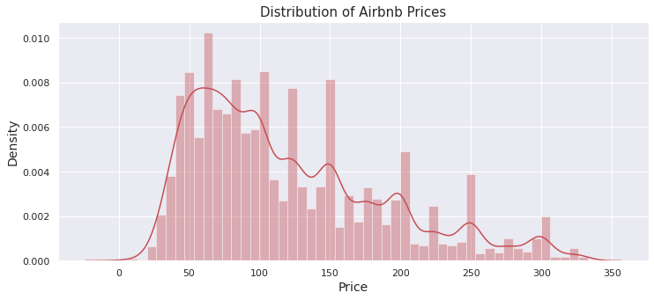
Distribution Of Airbnb Bookings Price Range Using Histogram
OBSERVATIONS :-
The range of prices being charged on Airbnb appears to be from 20$ to 330$ , with the majority of listings falling in the price range of 50$ to 150$ .
The distribution of prices appears to have a peak in the 50 to 150$ range, with a relatively lower density of listings in higher and lower price ranges.
There may be fewer listings available at prices above 250$ , as the density of listings drops significantly in this range.

Slide 10
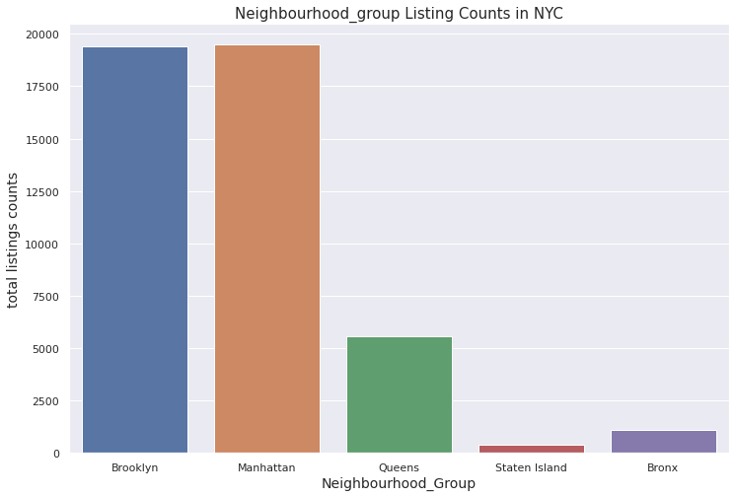
Total Listing/Property count in Each Neighborhood Group using Count plot
OBSERVATIONS :-
Manhattan and Brooklyn have the highest number of listings on Airbnb, with over 19,000 listings each.
Queens and the Bronx have significantly fewer listings compared to Manhattan and Brooklyn, with 5,567 and 1,070 listings and Staten Island has the fewest number of listings, with only 365.
Despite being larger in size, the neighborhoods in Queens, the Bronx, and Staten Island have fewer listings on Airbnb compared to Manhattan, which has a smaller geographical area.
This could suggest that the demand for Airbnb rentals is higher in Manhattan compared to the other neighborhoods, leading to a higher concentration of listings in this area
Neighborhood Groups | Listing Counts
Manhattan | 19501
Brooklyn | 19415
Queens | 5567
Bronx | 1070
Staten Island | 365
Alternatively, it could be that the supply of listings is higher in Manhattan due to a higher number of homeowners or property owners in this neighborhood who are willing to list their properties on Airbnb.

Slide 11
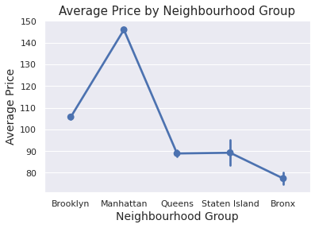
Average Price Of Each Neighborhood Group using Point Plot
OBSERVATIONS :-
The average price of a listing in New York City varies significantly across different neighborhoods, with Manhattan having the highest 146$/day average price and the Bronx having the lowest near 77$/day.
The average price increases as you move from the outer boroughs (Bronx, Brooklyn, Queens, and Staten Island) towards the center of the city (Manhattan).
The average price in queens and Staten Island is relatively similar, despite being in different parts of the city.
The data suggests that the overall cost of living in New York City is higher in the center of the city (Manhattan) compared to the outer boroughs. This is likely due to the fact that Manhattan is the most densely populated and commercially important borough, and therefore has higher demand for housing in the centrally located neighborhoods.
Neighborhood_Groups | Average_Price
Brooklyn | 105.70
Manhattan | 145.90
Queens | 88.90
Staten Island | 89.24
Bronx | 77.37

Slide 12
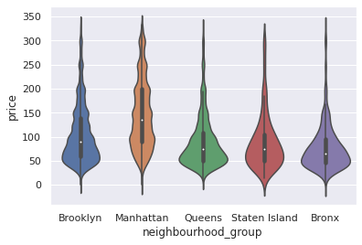
Price Distribution Of Each Neighborhood Group using Violin Plot
OBSERVATIONS :-
price distribution is very high in Manhattan and Brooklyn. but Manhattan have more Diversity in price range, you can see in violin plot.
Queens and Bronx have same price distribution but in Queens area more distribution in 50$ to 100$ but diversity in price is not like Manhattan and Brooklyn.

Slide 13
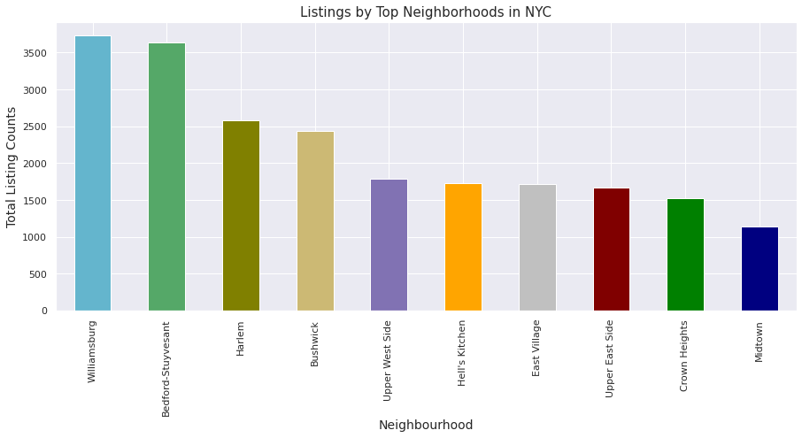
Top Neighborhoods by Listing/property using Bar plot
Top Neighborhoods | Total Listings
Williamsburg | 3732
Bedford-Stuyvesant | 3638
Harlem | 2585
Bushwick | 2438
Upper West Side | 1788
Hell's Kitchen | 1731
East Village | 1714
OBSERVATIONS :-
The top neighborhoods in New York City in terms of listing counts are Williamsburg, Bedford-Stuyvesant, Harlem, Bushwick, and the Upper West Side.
The top neighborhoods are primarily located in Brooklyn and Manhattan. This may be due to the fact that these boroughs have a higher overall population and a higher demand for housing.

Slide 14
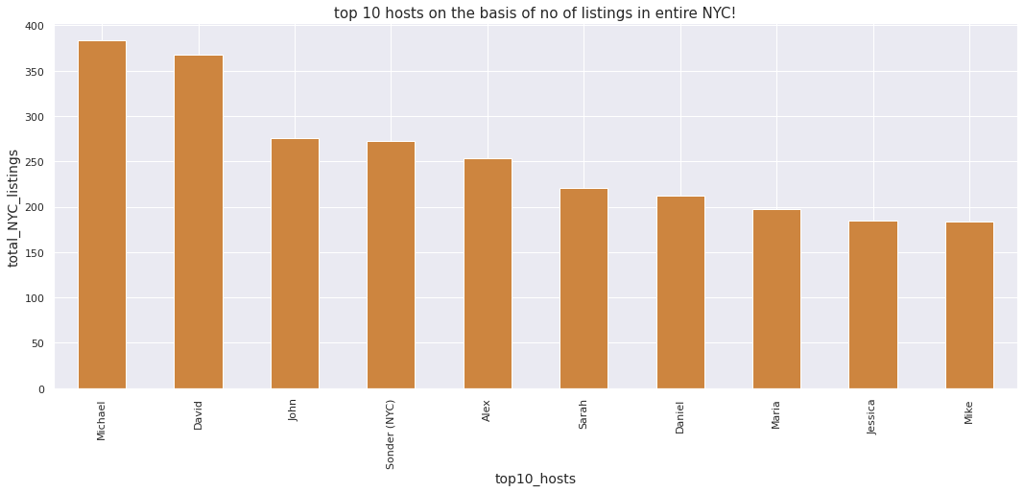
Top Hosts With More Listing/Property using Bar chart
Top Hosts | Total Listings
Michael | 383
David | 368
John | 276
Sonder (NYC) | 272
Alex | 253
Sarah | 221
OBSERVATIONS :-
The top three hosts in terms of total listings are Michael, David, and John, who have 383, 368, and 276 listings, respectively.
There is a relatively large gap between the top two hosts and the rest of the hosts. For example, john has 276 listings, which is significantly fewer than Michael's 383 listings.
There are relatively few hosts with a large number of listings. This could indicate that the Airbnb market is relatively competitive, with a small number of hosts dominating a large portion of the market.

Slide 15
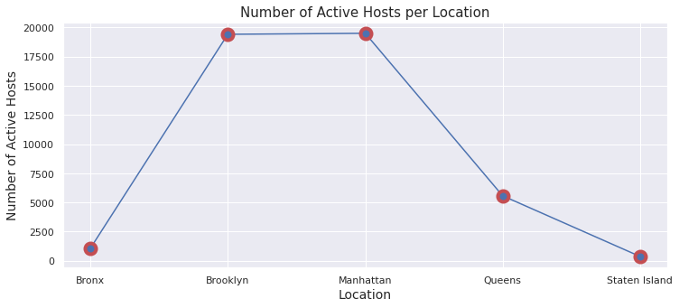
Number Of Active Hosts Per Location Using Line Chart
Neighborhood Groups | Active Hosts
Manhattan | 19501
Brooklyn | 19415
Queens | 5567
Bronx | 1070
Staten Island | 365
OBSERVATIONS :-
Manhattan has the largest number of hosts with 19501,Brooklyn has the second largest number of hosts with 19415.
After that Queens with 5567 and the Bronx with 1070. while Staten Island has the fewest with 365 Hosts.
Brooklyn and Manhattan have the largest number of hosts, with more than double the number of hosts in Queens and more than 18 times the number of hosts in the Bronx.

Slide 16
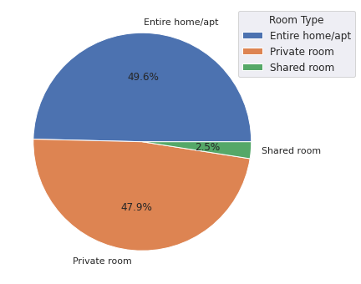
Total Counts Of Each Room Types in entire Nyc Using Pie Chart
Room Types | Total Counts
Entire Home/Apt | 22784
Private Room | 21996
Shared Room | 1138
OBSERVATIONS :-
The majority of listings on Airbnb are for entire homes or apartments, with 22784 listings, followed by private rooms with 21996 listings, and shared rooms with 1138 listings.
There is a significant difference in the number of listings for each room type. For example, there are almost 20 times as many listings for entire homes or apartments as there are for shared rooms.
The data suggests that travelers using Airbnb have a wide range of accommodation options to choose from, including private rooms and entire homes or apartments

Slide 17
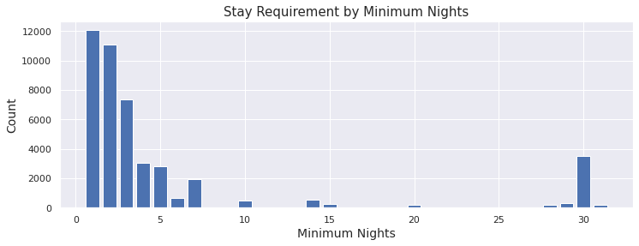
Stay Requirement counts by Minimum Nights using Bar chart
OBSERVATIONS :-
The majority of listings on Airbnb have a minimum stay requirement of 1 or 2 nights, with 12067 and 11080 listings, respectively.
The number of listings with a minimum stay requirement decreases as the length of stay increases, with 7375 listings requiring a minimum stay of 3 nights, and so on.
There are relatively few listings with a minimum stay requirement of 30 nights or more, with 3489 and 189 listings, respectively.

Slide 18
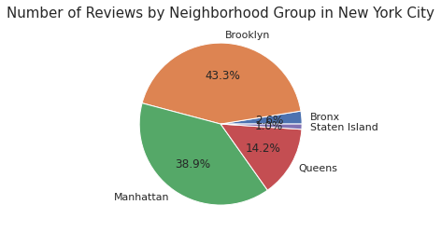
Total Reviews by Each Neighborhood Group using Pie Chart
OBSERVATIONS :-
Brooklyn has the largest share of total reviews on Airbnb, with 43.3%, followed by Manhattan with 38.9%.
Queens has the third largest share of total reviews, with 14.2%, followed by the Bronx with 2.6% and Staten Island with 1.0%.
The data suggests that Airbnb is more popular in Brooklyn and Manhattan compared to the other neighborhood groups.
Despite having fewer listings, Brooklyn has more reviews on Airbnb compared to Manhattan. This could indicate that Airbnb users in Brooklyn are more likely to leave reviews, or that the listings in Brooklyn are more popular or successful in generating positive reviews. It is worth noting that there could be a number of other factors that could contribute to this difference in reviews, such as the quality of the listings or the characteristics of the travelers who use Airbnb in these areas.

Slide 19
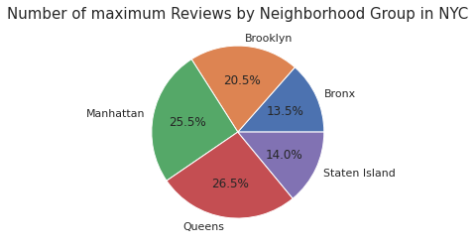
Number of Max. Reviews by Each Neighborhood Group using Pie Chart
OBSERVATIONS :-
Queens and Manhattan seem to be the most popular neighborhoods for reviewing, as they have both high number of maximum reviews.
Queens has the highest percentage of reviews at 26.5%, but it has the third highest number of listings, behind Manhattan and Brooklyn. This suggests that Queens may be a particularly popular destination for tourists or visitors, even though it has fewer listings compared to Manhattan and Brooklyn.
Manhattan and Brooklyn also have a high percentage of reviews, at 25.5% & 20.5%. This indicates that it is a popular destination for tourists or visitors as well… (number of listings higher than queens).
Overall, this data suggests that Queens, Manhattan, and Brooklyn are the most popular neighborhoods for tourists or visitors, based on the high number of reviews they receive.

Slide 20
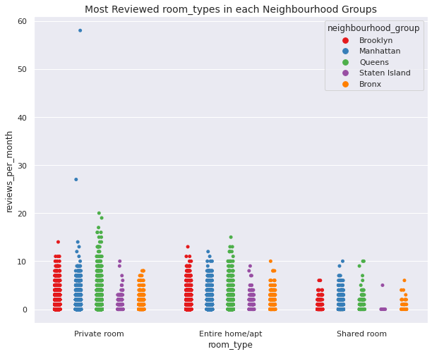
Most Reviewed Room Type Per Month In Neighborhood groups
OBSERVATIONS :-
We can see that Private room received the most no of reviews/month where Manhattan had the highest reviews received for Private rooms with more than 50 reviews/month, followed by Manhattan in the chase.
Manhattan & Queens got the most no of reviews for Entire home/apt room type.
There were less reviews received from shared rooms as compared to other room types and it was from Staten Island followed by Bronx.

Slide 21
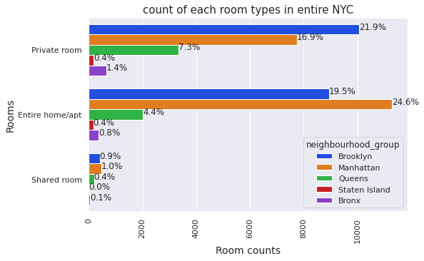
Count Of Each Room Types In Entire NYC Using Multiple Bar Plot
OBSERVATIONS :-
Manhattan has more listed properties with Entire home/apt around 24.6% of total listed properties followed by Brooklyn with around 19.5%.
Private rooms are more in Brooklyn as in 21.9% of the total listed properties followed by Manhattan with 16.9% of them. While 7.3% of private rooms are from Queens.
Very few of the total listed have shared rooms listed on Airbnb where there's negligible or almost very rare shared rooms in Staten Island and Bronx.
We can infer that Brooklyn,Queens,Bronx has more private room types while Manhattan which has the highest no of listings in entire NYC has more Entire home/apt room types.

Slide 22
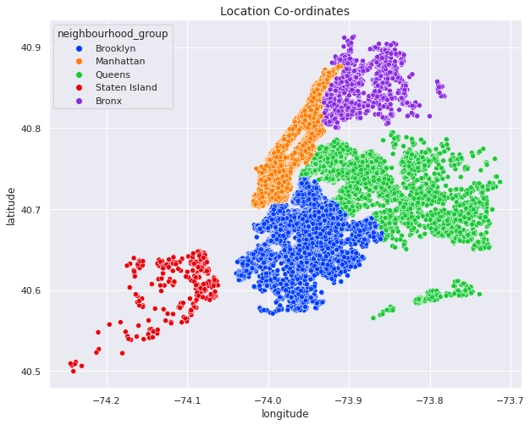
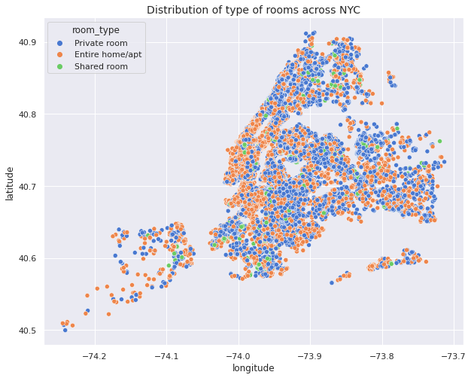
Distribution Of Room Types Across NYC

Slide 23
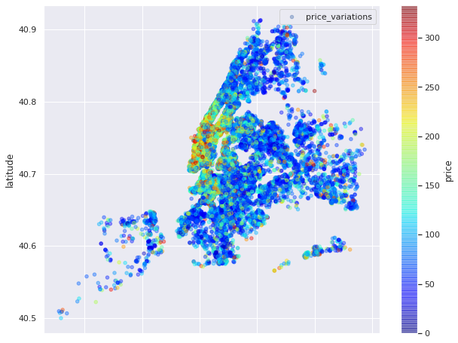
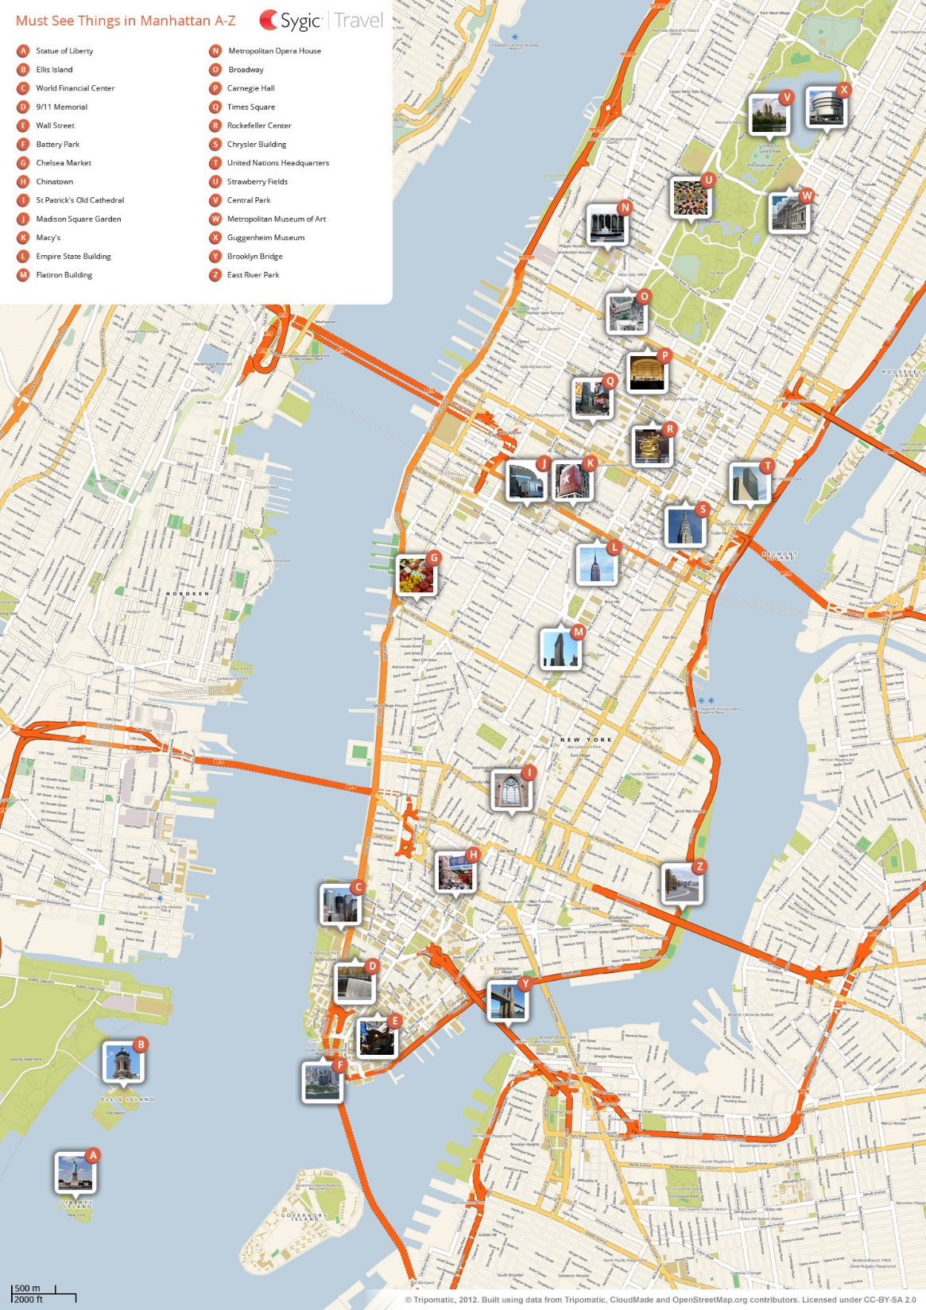
Price variations in NYC Neighborhood groups using scatter plot
OBSERVATIONS :-
The range of prices for accommodations in Manhattan is particularly high, indicating that it is the most expensive place to stay in NYC due to its various attractive amenities, as shown in the attached image
They are likely to attract a lot of tourists or visitors because of more valuable things to visit so price is higher than other neighborhood groups. Travelers are likely to spent more days in this area because of popular amenities, high concentration of tourist attractions and public transports.

Slide 24
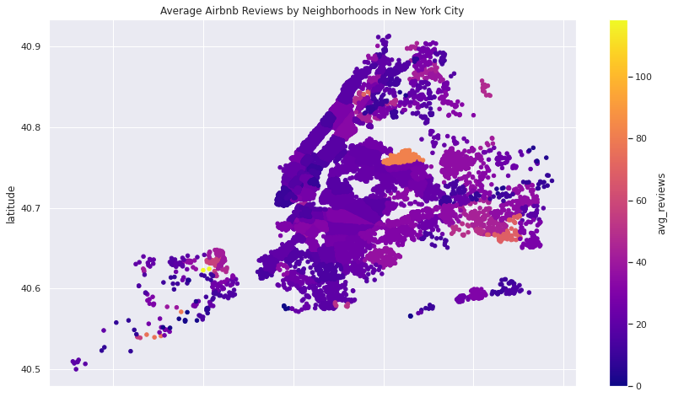
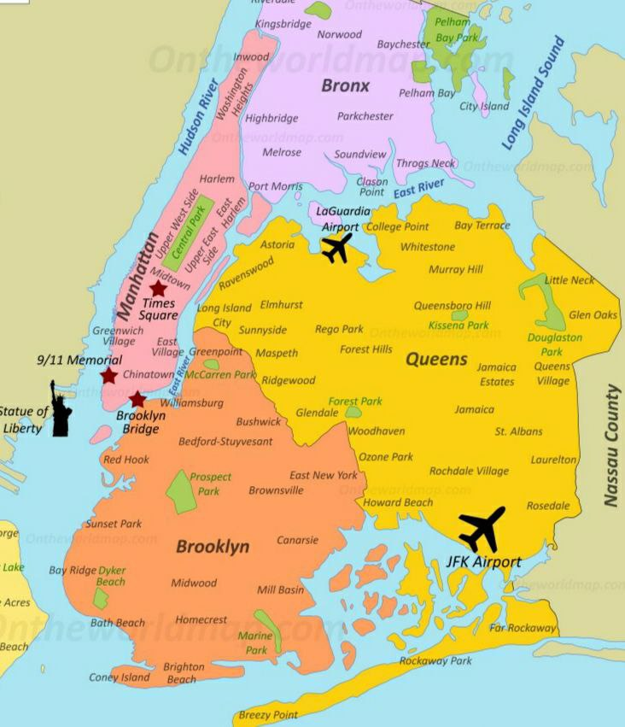
Find Best Location Listing/Property Location For Travelers and Hosts
OBSERVATIONS :-
I have attached a photo of this map because of some valuable insight. The neighborhoods near the airport in Queens would have a higher average number of reviews, as they are likely to attract a lot of tourists or visitors who are passing through the area. The proximity to the airport could make these neighborhoods a convenient and appealing place to stay for travelers for short-term stay.
There could also be other factors contributing to the high average number of reviews in these neighborhoods. For example, they may have a higher concentration of high-quality listings or attractions that attract more visitors and result in more reviews and Airport is key factor.

Slide 25
BUSINESS CONCLUSION
Manhattan and Brooklyn have the highest demand for Airbnb rentals, as evidenced by the large number of listings in these neighborhoods. This could make them attractive areas for hosts to invest in property.
Manhattan is world-famous for its parks, museums, buildings, town, liberty, gardens, markets, island and also its substantial number of tourists throughout the year ,it makes sense that demand and price both high.
Brooklyn comes in second with significant number of listings and cheaper prices as compared to the Manhattan: With most listings located in Williamsburg and Bedford Stuyvesant two neighborhoods strategically close to Manhattan tourists get the chance to enjoy both boroughs equally while spending less.
Williamsburg, Bedford-Stuyvesant, Harlem, Bush wick, and the Upper West Side are the top neighborhoods in terms of listing counts, indicating strong demand for Airbnb rentals in these areas.
The average price of a listing in New York City is higher in the center of the city (Manhattan) compared to the outer boroughs. This could indicate that investing in property in Manhattan may be more lucrative for Airbnb rentals.
But Manhattan and Brooklyn have the largest number of hosts, indicating a high level of competition in these boroughs.
The data suggests that Airbnb rentals are primarily used for short-term stays, with relatively few listings requiring a minimum stay of 30 nights or more. Hosts may want to consider investing in property that can accommodate shorter stays in order to maximize their occupancy rate.
The majority of listings on Airbnb are for entire homes or apartments and also Private Rooms with relatively fewer listings for shared rooms. This suggests that travelers using Airbnb have a wide range of accommodation options to choose from, and hosts may want to consider investing in property that can accommodate multiple guests.

Slide 26

BUSINESS CONCLUSION
The data indicates that there is a high level of competition among Airbnb hosts, with a small number of hosts dominating a large portion of the market. Hosts may want to consider investing in property in areas with relatively fewer listings in order to differentiate themselves from the competition.
The data indicates that the availability of Airbnb rentals varies significantly across neighborhoods, with some neighborhoods having a high concentration of listings and others having relatively few.
The neighborhoods near the airport in Queens would have a higher average number of reviews, as they are likely to attract a lot of tourists or visitors who are passing through the area. The proximity to the airport could make these neighborhoods a convenient and appealing place to stay for travelers for short-term stay with spending less money because The price distribution is high in Manhattan and Brooklyn.

Slide 27


